Slide 1
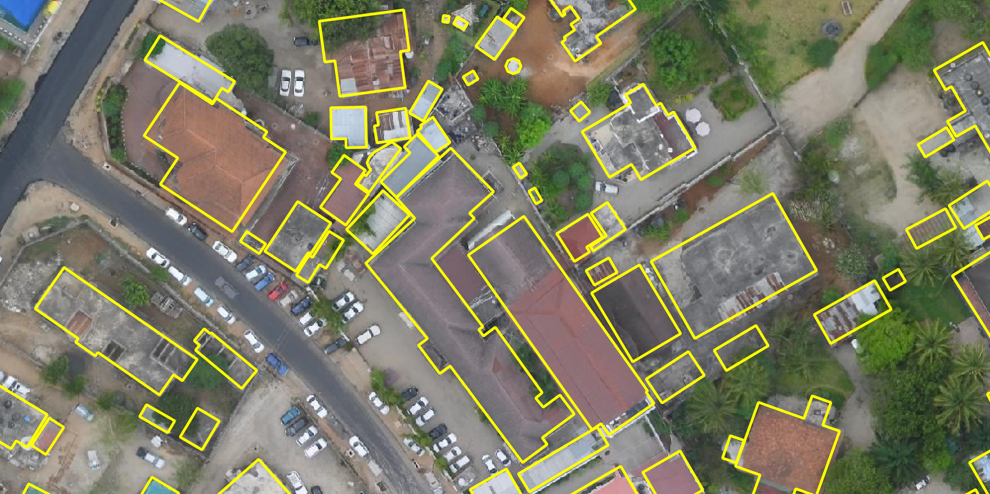
Jamaica cleaner+ Aalyah Johnson Jevon Fairman Marshagay Butler Kavian Peart Tamara Reynolds
Open Cities: Jamaica Hackathon

Slide 2
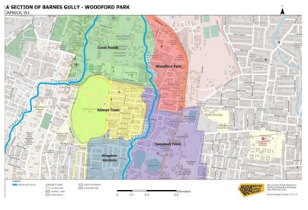
About Open Cities: Jamaica
The project recruited participants from Allman Town and Kingston Gardens, St. Patrick’s Rangers, and graduates of existing CSOD programmes.
Participants were trained and participated in a field mapping exercise, mapping in Allman Town and Kingston Gardens along the Barnes Gully and the surrounding areas.
The data collected will form the main dataset for the Hackathon.

Slide 3


Slide 4
Solid Waste Management
Has been growing problem in Jamaica Of the 800,000 tons of residential waste, Jamaica generates annually, 15 per cent is estimated to be plastics. While three-quarters of this is disposed of at legal disposal sites, the remainder often ends up in drains, rivers, gullies, beaches and, ultimately, the ocean. They lack conventional solid waste disposal site equipment, resulting in inadequate and improper burial of solid waste.

Slide 5
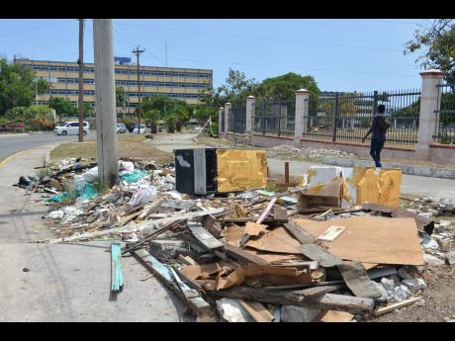
Ministry of finance

Slide 6
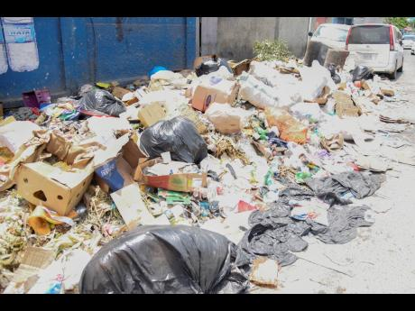
Allman town

Slide 7
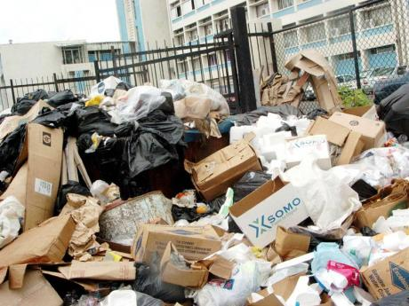
Allman Town

Slide 8
Who are the our targeted users?
Who are the targeted users? The target market for waste management services includes Communities, businesses and organizations that generate a lot of waste and need to ensure compliance with waste disposal regulations. These organizations include factories, hospitals, farms, industries like chemical & pharma companies, construction sites and cities

Slide 9
Why does the problem matter:
Due to the fact that most activities involve solid waste management (SWM). The collection, segregation, transportation, disposal, processing, recycling and treatment are not effectively handled and managed in cities and towns in Jamaica. The dumping of solid waste in the vicinity of city and towns has seriously affected the surrounding air, soil and water bodies. Today, we are facing with nearly 80 percent of generated solid waste going unprocessed. This is compounded by rapid urbanization, increased rural-urban migration and the complexity of waste management in largely unplanned and expanding. Allman Town is located in Kingston, Jamaica, and with its dynamic population and constantly evolving infrastructure, it is an example of a city that requires concerted efforts from all stakeholders to ensure that waste is managed in a sustainable manner.

Slide 10
How do we solve this problem:
While municipal efforts are on track to achieve the objective of complete scientific solid waste management under the mission Stakeholders’ participation is critical to ensure a comprehensive approach to the same. The focus of the present study is an overview of the existing municipal solid waste management systems in Allman Town. The major issues and the feasible solutions for management of municipal solid waste on sustainable basis have also been outlined.

Slide 11
Approaches
Category | Community Engagement
Problem | Improperly managed disposal points, minimal – no timely collection leading to overflowing of garbage collection receptacles & Gullies clogged with garbage that cause flooding
Solution | Jamaica Cleaner+ App
Description | The app consists of a citizen/business log in, as well as in interface for government agencies that facilitate waste management. The aim of the app is to bridge the gap between community members and these government agencies, as well as each other. The app is a platform that allows to effectively communicate how, when and where solid waste should be properly disposed.
Target | Government agencies National works agency ( drain cleaning ) National solid waste agency( Garbage picking up and disposal), Office of disaster preparedness and awareness and Community Residents

Slide 12
Associated costs and timeline
Stage 1: Planning and Analysis
Stage 2: Design
Stage 3: Development
Stage 4: Testing and Quality Assurance
Stage 5: Deployment and Launch
Stage 6: Post Launch Maintainance

Slide 13
Thank you for your attention

